Slide 1
DIGITAL LOGIC DESIGN
EE(109)
LECTURE-5
DATE: 30TH JAN,2018

Slide 2
Chapter No:2
Number System, Operation and Codes

Slide 3
CHAPTER OUTLINE
Decimal Numbers
Binary Numbers
Decimal-to-Binary Conversion
Binary Arithmetic
Complements of Binary Numbers
Signed Numbers
Arithmetic Operations with Signed Numbers
Hexadecimal Numbers
Octal Numbers
Binary Coded Decimal (BCD)
Digital Codes
Error Codes

Slide 4
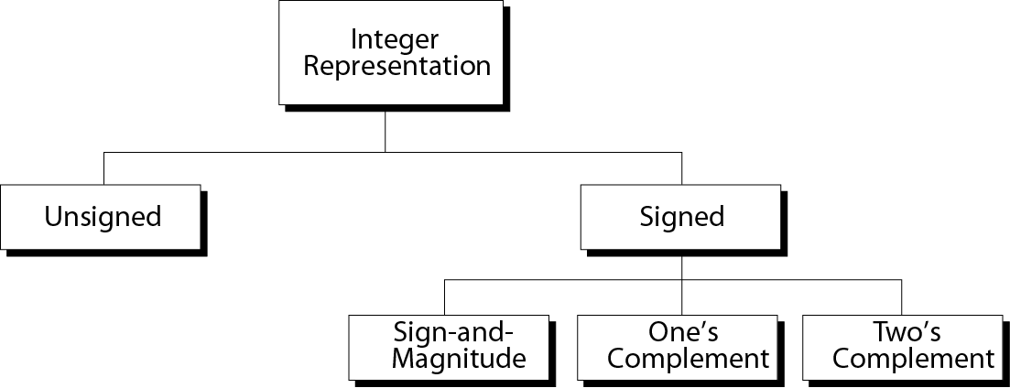
Taxonomy of integers

Slide 5
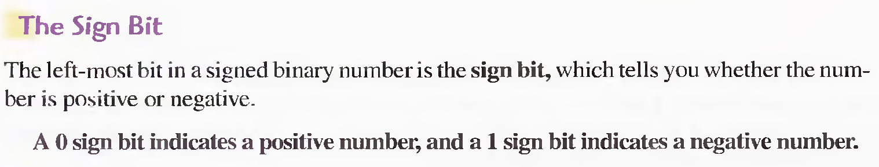
Signed Numbers
Digital systems, such as the computer, must be able to handle both positive and negative numbers. A signed binary number consists of both sign and magnitude information. The sign indicates whether a number is positive or negative, and the magnitude is the value of the number. There are three forms in which signed integer (whole) numbers can be represented in binary:
Sign-magnitude,
1's complement, and
2' complement.

Slide 6
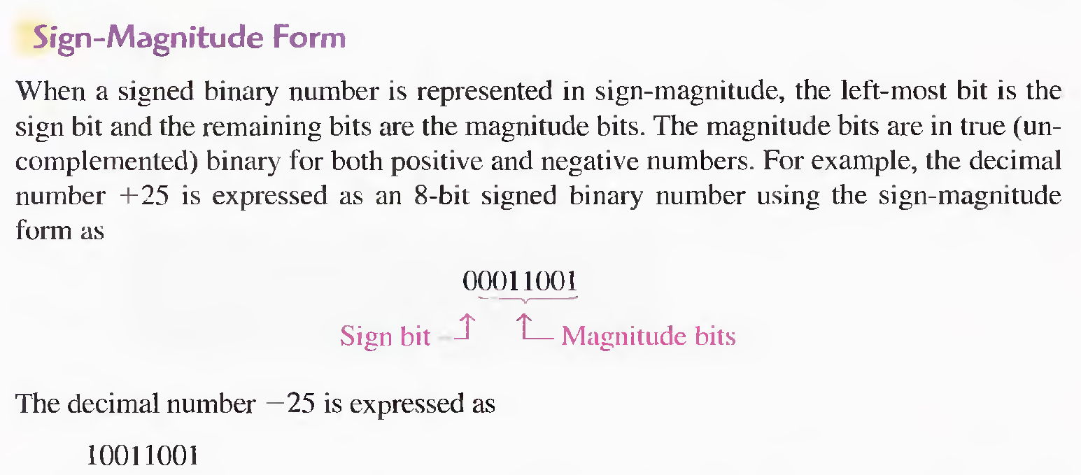
Signed Numbers

Slide 7
Signed Numbers
1’s and 2’s Complement forms
Positive numbers in I's and 2’s complement forms are represented the same way as the positive sign- magnitude numbers. Negative numbers, however, are the l's and 2’s complements of the corresponding positive numbers.
1’s Complement :
The decimal number -25 is expressed as the I' s complement of + 25 (0001100 I ) as 11100110
2’s Complement :
The decimal number -25 is expressed as the 2' s complement of + 25 (0001100 I ) as 11100111

Slide 8
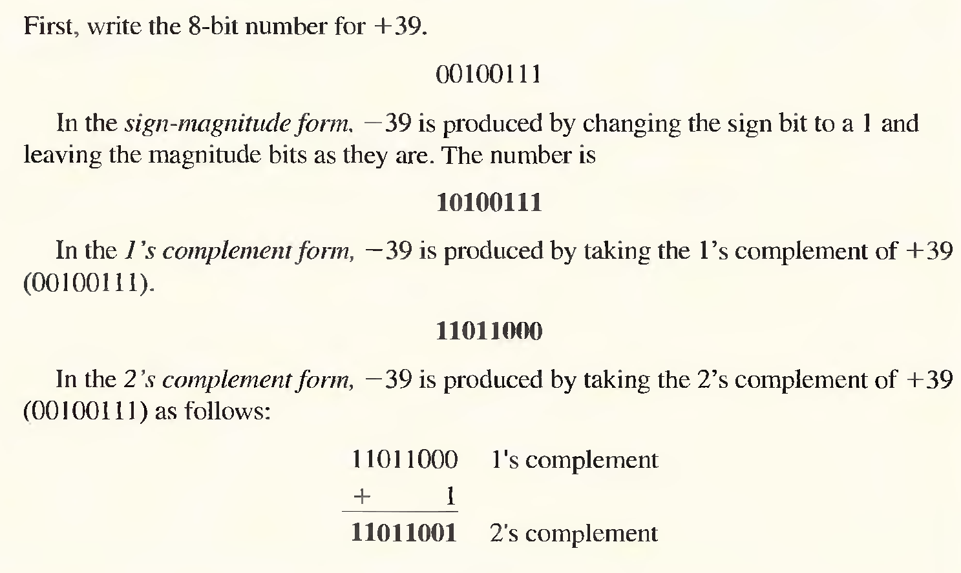
Examples (Signed Numbers)

Slide 9
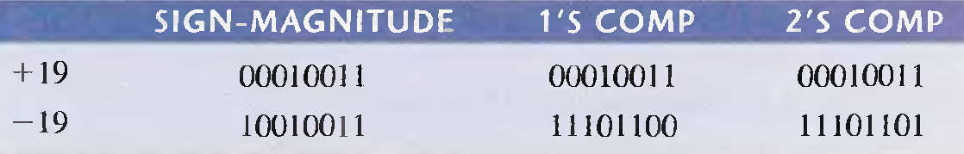
Examples (Signed Numbers)
Express + 19 and - 19 in sign-magnitude, I's complement, and 2's complement.

Slide 10
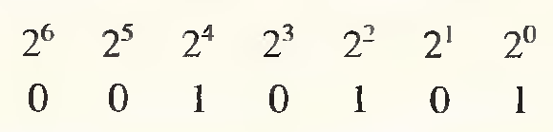

The Decimal Value of Signed Numbers
The seven magnitude bits and their powers-of-two weights are as follows:
Summing the weights where there are 1s,
The sign bit is 1; therefore, the decimal number is -21
01110111 = +119 10

Slide 11

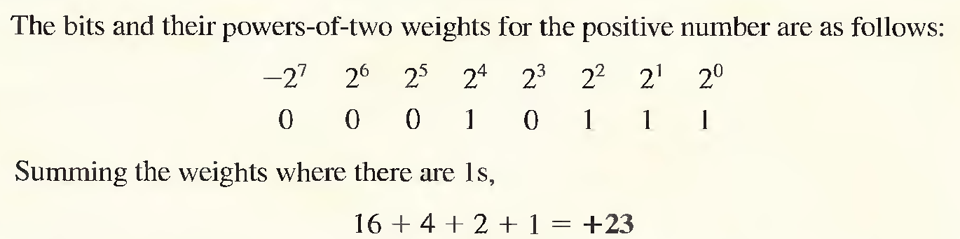
The Decimal Value of Signed Numbers
1’s Complement

Slide 12

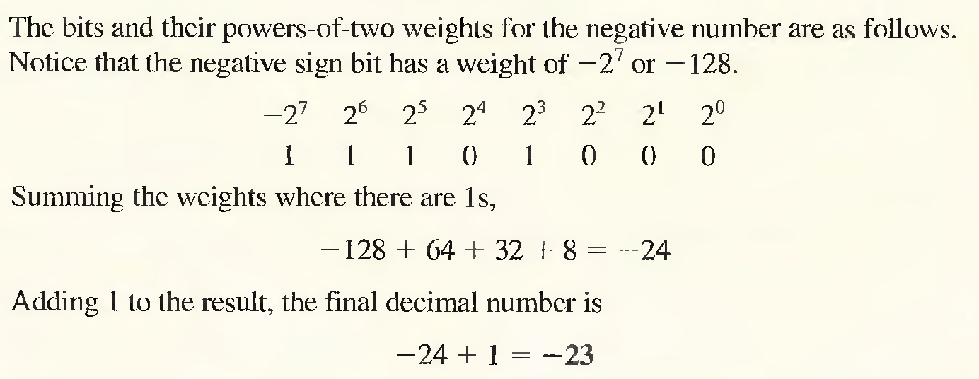
The Decimal Value of Signed Numbers
1’s Complement
-20

Slide 13
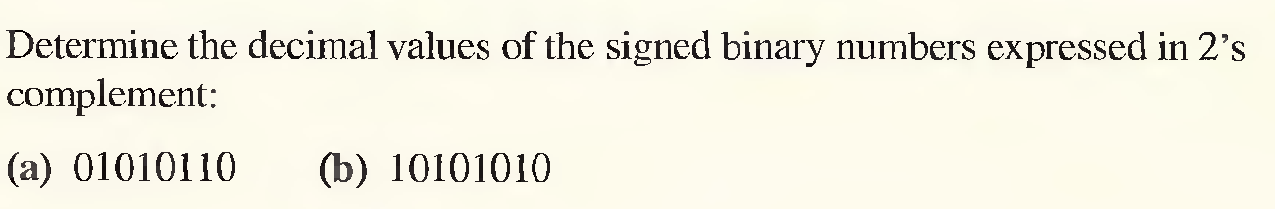
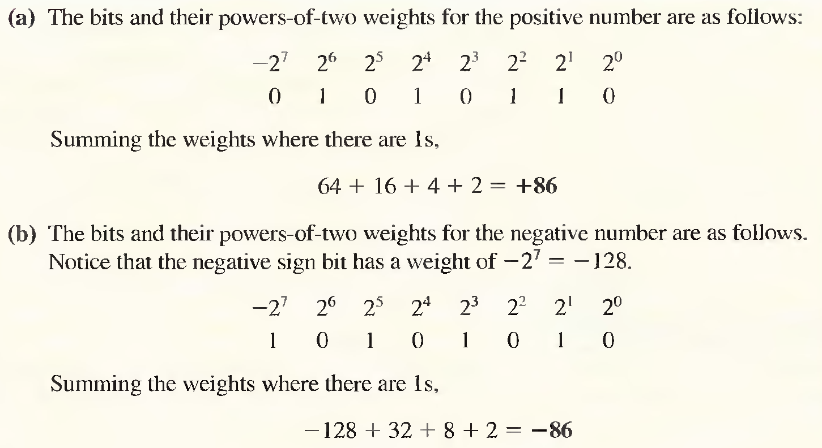
The Decimal Value of Signed Numbers
2’s Complement
-41

Slide 14
Summary of integer representation
Contents of Memory
------------
0000
0001
0010
0011
0100
0101
0110
0111
1000
1001
1010
1011
1100
1101
1110
1111
Unsigned
------------
0
1
2
3
4
5
6
7
8
9
10
11
12
13
14
15
Sign-and-Magnitude
−−−−−−−−−
+0
+1
+2
+3
+4
+5
+6
+7
−0
−1
−2
−3
−4
−5
−6
−7
One’s
Complement
−−−−−−−−−
+0
+1
+2
+3
+4
+5
+6
+7
−7
−6
−5
−4
−3
−2
−1
−0
Two’s
Complement
−−−−−−−−
+0
+1
+2
+3
+4
+5
+6
+7
−8
−7
−6
−5
−4
−3
−2
−1

Slide 15
Range of unsigned integers
# of Bits
---------
8
16
Range
-------------------------------------
0 255
0 65,535

Slide 16
Range of sign-and-magnitude integers
# of Bits
----------
8
16
32
Range
-------------------------------------------------------
−127 −0
−32767 −0
−2,147,483,647 −0
+0 +127
+0 +32767
+0 +2,147,483,647

Slide 17

Note:
There are two 0s in one’s complement
representation: positive and negative.
In an 8-bit allocation:
+0 ➔ 00000000
-0 ➔ 11111111

Slide 18
Range of two’s complement integers
# of Bits
---------
8
16
32
Range
-------------------------------------------------------
−128
−32,768
−2,147,483,648
0 +127
0 +32,767
0 +2,147,483,647

Slide 19
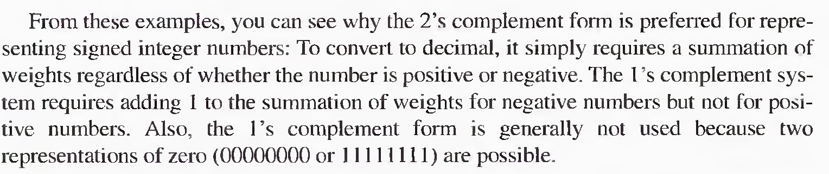
The Decimal Value of Signed Numbers
1’s and 2’s Complement

